Slide 1

Micro-Credit Defaulter Model
Presented by: Vipin Kumar

Slide 2
Introduction
A Microfinance Institution (MFI) is an organization that offers financial services to low income populations. MFS becomes very useful when targeting especially the unbanked poor families living in remote areas with not much sources of income. The Microfinance services (MFS) provided by MFI are Group Loans, Agricultural Loans, Individual Business Loans and so on.
Many microfinance institutions (MFI), experts and donors are supporting the idea of using mobile financial services (MFS) which they feel are more convenient and efficient, and cost saving, than the traditional high-touch model used since long for the purpose of delivering microfinance services. Though, the MFI industry is primarily focusing on low income families and are very useful in such areas, the implementation of MFS has been uneven with both significant challenges and successes.
We are working with one such client that is in Telecom Industry. They are a fixed wireless telecommunications network provider. They have launched various products and have developed its business and organization based on the budget operator model, offering better products at Lower Prices to all value conscious customers through a strategy of disruptive innovation that focuses on the subscriber.
They are collaborating with an MFI to provide micro-credit on mobile balances to be paid back in 5 days. The Consumer is believed to be defaulter if he deviates from the path of paying back the loaned amount within the time duration of 5 days. For the loan amount of 5 (in Indonesian Rupiah), payback amount should be 6 (in Indonesian Rupiah), while, for the loan amount of 10 (in Indonesian Rupiah), the payback amount should be 12 (in Indonesian Rupiah).
The sample data is provided to us from our client database. It is hereby given to you for this exercise. In order to improve the selection of customers for the credit, the client wants some predictions that could help them in further investment and improvement in selection of customers.

Slide 3
Problem Statement
Build a model which can be used to predict in terms of a probability for each loan transaction, whether the customer will be paying back the loaned amount within 5 days of insurance of loan. In this case, Label ‘1’ indicates that the loan has been payed i.e. Non- defaulter, while, Label ‘0’ indicates that the loan has not been payed i.e. defaulter.

Slide 4
Hardware and Software Requirements and Tools Used
Python(jupyter notebook)
Pandas
Numpy
Matplotlib
Seaborn
Sklearn
Classification models
Grid search
Evaluation metrics
Ensembling

Slide 5
Mathematical/ Analytical Modelling of the Problem
As we have seen in problem statement that it’s a classification problem where we have to identify whether the customer will be paying back the loaned amount within 5 days of insurance of loan or not.
So we will use 4 important classification algorithms to solve this problem and
Will finalize any one which prediction is best among all.
Algorithms we will use are :
Testing of Identified Approaches (Algorithms)
LogisticRegression
RandomForestClassifier
AdaBoostClassifier
XGBClassifier

Slide 6
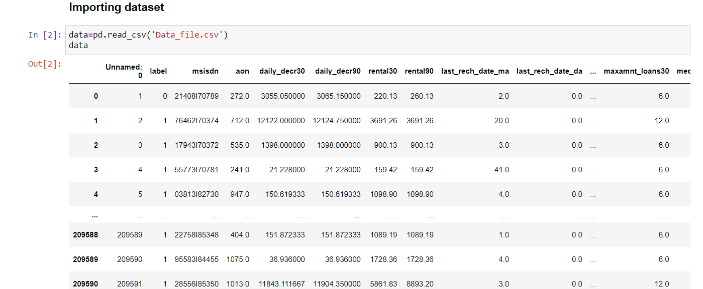
Data Sources and their formats
The Microfinance services (MFS) provided by MFI are Group Loans, Agricultural Loans, Individual Business Loans and so on. The sample data is provided to us from our client database. It is hereby given to you for this exercise. In order to improve the selection of customers for the credit, the client wants some predictions that could help them in further investment and improvement in selection of customers. Dataset contain 209593 observations and 36 features. Label contain Flag indicating whether the user paid back the credit amount within 5 days of issuing the loan{1:success, 0:failure}. It was provided in as csv file.

Slide 7
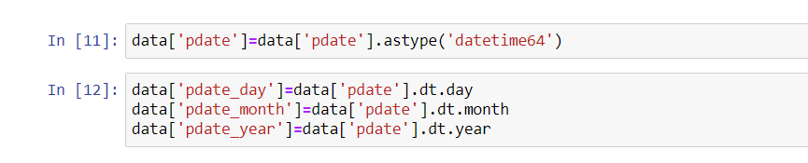
Data Pre-processing Done
Feature ['Unnamed: 0'] having id & ['msisdn'] have mobile number so both unique identity features so we can simply remove it.
As we can see 31 duplicate observation found in dataset and removed now.
Dataset have no null values
Feature pdate contains date as model cant process data as its so i have extracted day/month/year in separate columns.

Slide 8
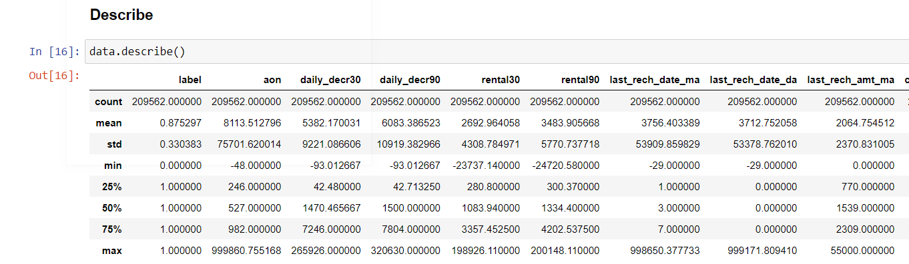
Data Describe
Observation:
In feat. 'aon' min value showing in negative & max showing 999860 both value are outliers.
in feat. 'daily_decr30' min value in negatibe & max showing 265926 both values seems outliers.
in feat. 'daily_decr90' min value in negatibe & max showing 320630. both values seems outliers.
rental30 negative values are outliets.
rental90 negative values are outliets.
last_rech_date_ma negative values are outliers.
last_rech_date_da negative values are outliers.
medianmarechprebal30 negative values are outliers.
medianmarechprebal90 negative values are outliers.
cnt_loans90 max value is also outliers.
few others are having min value as 0 that also seems outliers.

Slide 9
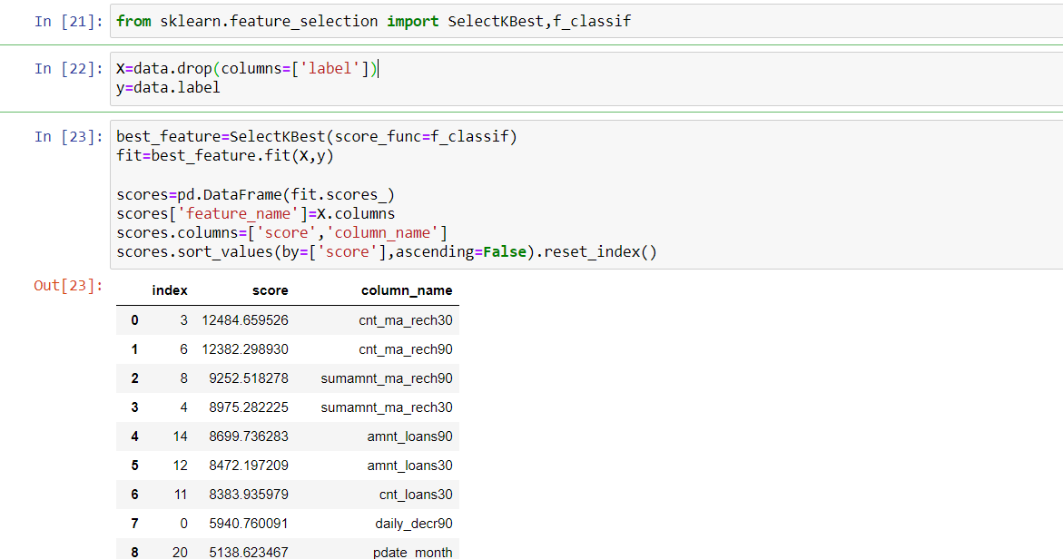
Feature selection
As we have many features in dataset and some features have very less or no relation with target label. so we will apply feature selection to select best features. I will use sklearn tool SelectKBest and function-f_classif.

Slide 10
Visualizations
Heatmap
Heat map draw for correlation and multicollinearity.
daily_decr30 have multicollinearity with daily_decr90 and rental30 have with rental90. so we can remove one from each pair.
few feature have very or no correlation with label so we can remove these features.
fr_da_rech90 -0.007200
medianmarechprebal30 -0.004101
aon -0.003016
fr_da_rech30 -0.000827
maxamnt_loans30 0.000461
fr_ma_rech30 0.000559
cnt_da_rech90 0.000783
last_rech_date_da 0.000900
last_rech_date_ma 0.003305
cnt_da_rech30 0.004313
cnt_loans90 0.004460

Slide 11
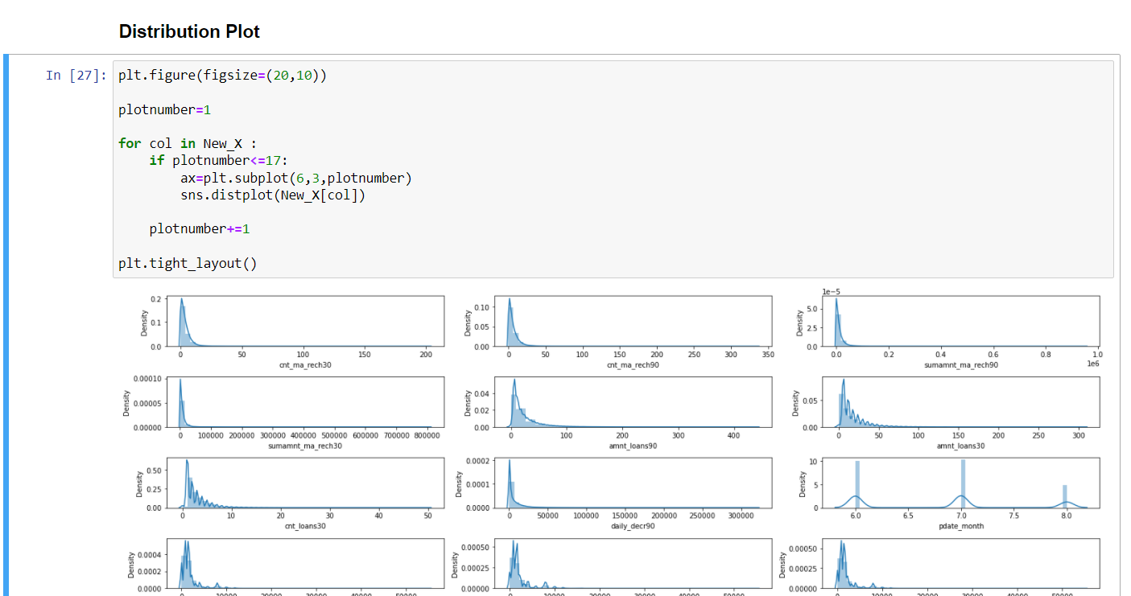
Distribution Plot As we can clearly see all features having outliers and right skewness. so we will apply z_score method here to remove outliers.

Slide 12
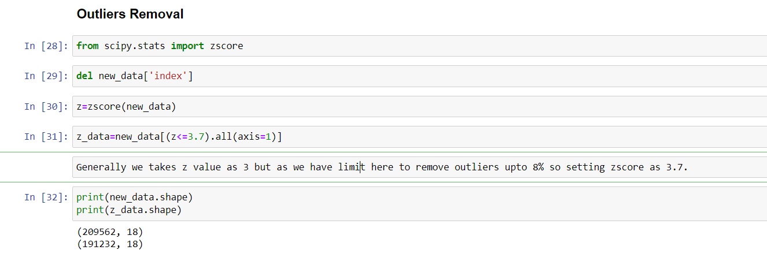
Outliers Removal
Generally we takes z value as 3 but as we have limit here to remove outliers upto 8% so setting zscore as 3.7.

Slide 13
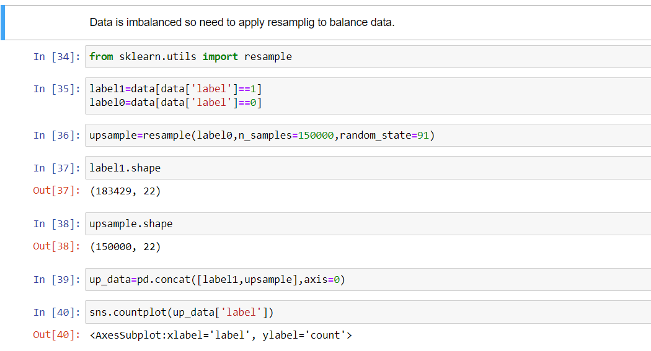
Data Imbalancing
The dataset is imbalanced. Label ‘1’ has approximately 87.5% records, while, label ‘0’ has approximately 12.5% records. if the data set in imbalance then In such cases, you get a pretty high accuracy just by predicting the majority class, but you fail to capture the minority class, which is most often the point of creating the model in the first place.
So to balance both the classes I will implement resampling

Slide 14
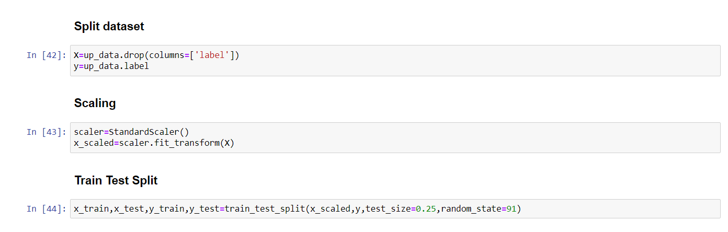
Preprocessing-Scaling/Splitting/Train_test_split
Scaling-Scaling is very important part in machine learning as we have different features which have values in different scale. So can be biased for some particular features. So its good idea to convert all features in same scaling. We will use standard scaler here.
Splitting-As our dataset is ready now to building model but before that we will split data X-as features and y-as classification label.
Train_test_split-Its last but most important part before apply ML algorithms.
It will split our data set as training data-in which model will be train, Testing data-in which model to be evaluate.

Slide 15
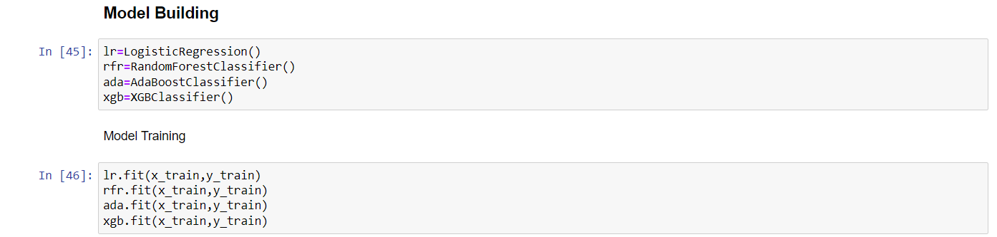
Run and Evaluate selected models
Testing of Identified Approaches (Algorithms)
LogisticRegression
RandomForestClassifier
AdaBoostClassifier
XGBClassifier
As its classification model so will try to 4 algorithms here, out of all 3 algorithms are ensemble algorithms.

Slide 16
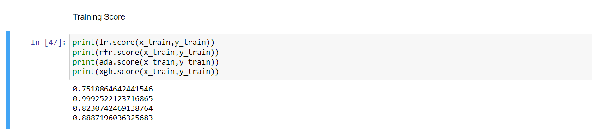
Run and Evaluate selected models
In previous slide we have seen that we applied 4 algorithms and trained all. Here we will check training score of each algorithm and then we will give test data to all models. After that we will check score of individual algorithm.
Here its clearly shown that Random forest training score is maximum and its around 100%.

Slide 17
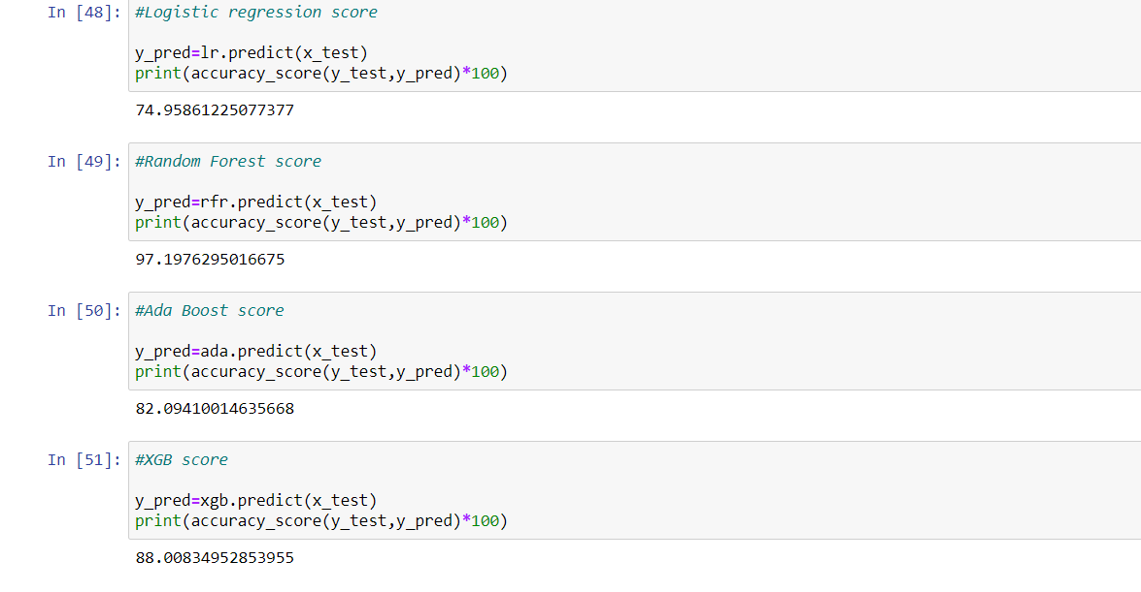
Run and Evaluate selected models
Evaluation (Test Data)
Here we can see Random forest classifier predicting with highest accuracy i.e. around 97%

Slide 18
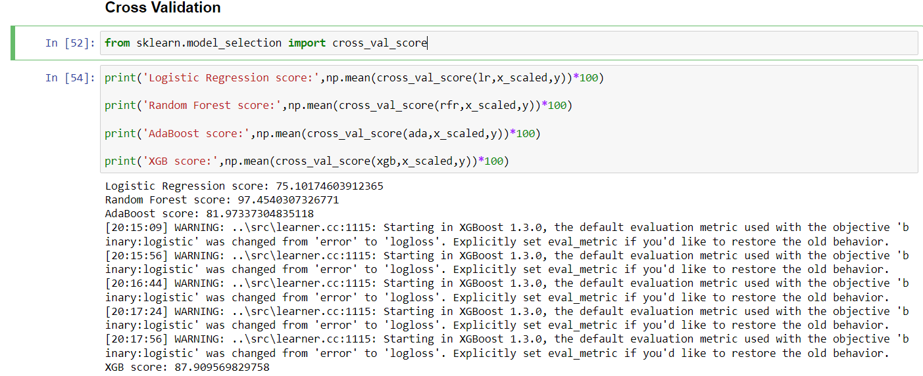
Cross Validation
Cross validation is most important part to check model overfitting/ under fitting .we can consider a best which accuracy score is close to test score. We will do cross validation by cross_val_score
Here we can see Random forest cross validation score is best amongst all (97.45%)its very close to test accuracy score.

Slide 19
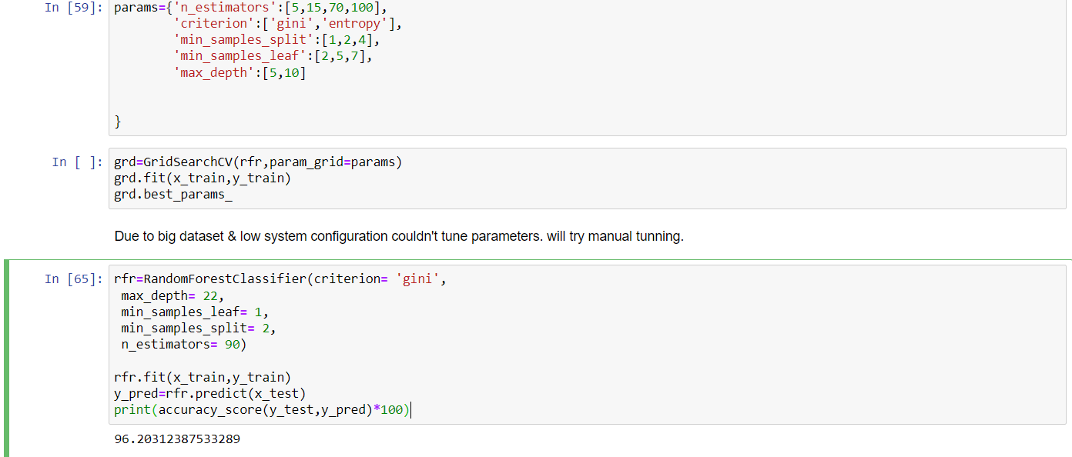
Hyperparameter Tuning
As Random forest is predicting with highest accuracy here so its our finalize model. Its predicting with 97.45% accuracy in cross validation but we can apply parameter tuning to use optimized parameters and it can improve our accuracy.
Due to big dataset & low system configuration couldn't tune parameters. I tried to tune some random parameters manually but its scoring same, so here we will go with default params.

Slide 20
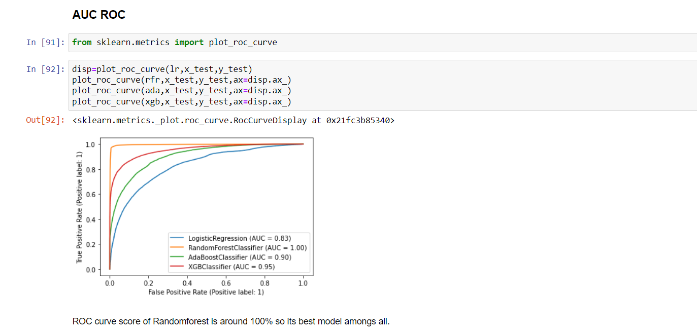
AUC ROC
In Machine Learning, performance measurement is an essential task. So when it comes to a classification problem, we can count on an AUC - ROC Curve. When we need to check or visualize the performance of the multi-class classification problem, we use the AUC (Area Under The Curve) ROC (Receiver Operating Characteristics) curve. It is one of the most important
In below AUC plot we can see random forest algorithms is best its scoring nearly 100%.

Slide 21
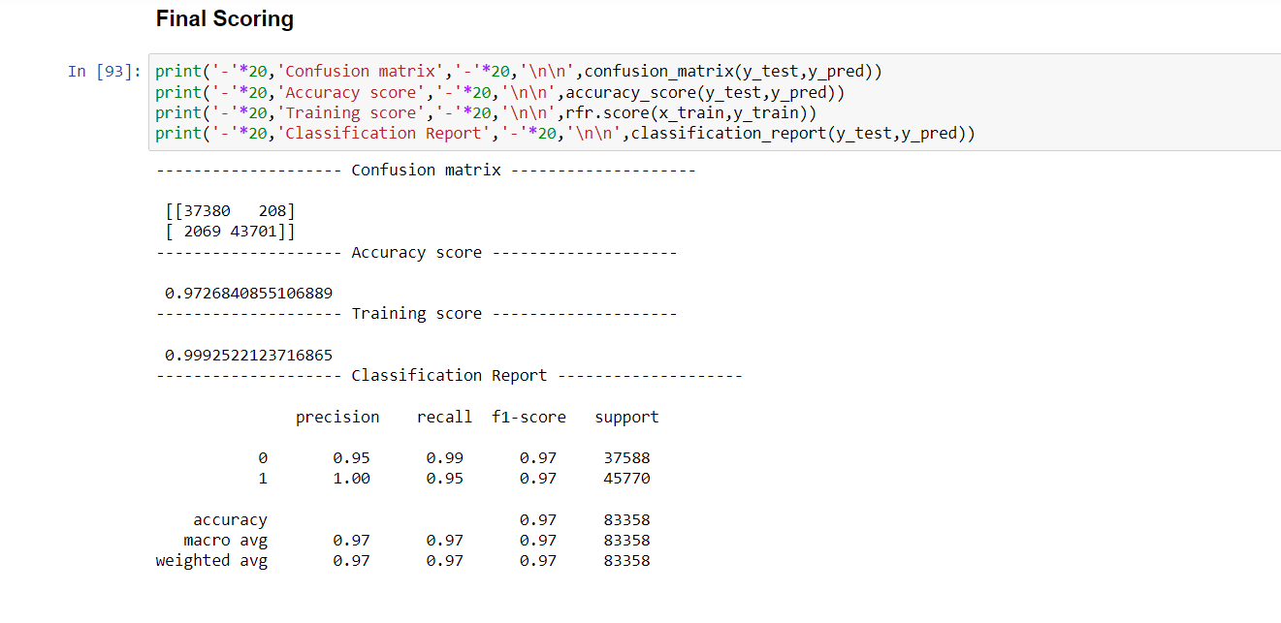
Final Score
As we go with 4 classification algorithms and find out random forest is working best. So here are the final scores for it.

Slide 22
CONCLUSION
Key Findings and Conclusions of the Study
There are no null values in the dataset.
The dataset is imbalanced. Label ‘1’ has approximately 87.5% records, while, label ‘0’ has approximately 12.5% records.
Some features are not useful so we can delete .
Many outliers are there in dataset.
Learning Outcomes of the Study in respect of Data Science
As we gone all points one by one we see a date feature and process it, in heatmap we see that few have multicollinearity problem, and few feature with very low or no correlation with target label, so could decide to remove those feature. We implement z-score to remove outliers within a given range.
Then we tried 4 algorithms and random forest classifier prediction accuracy is best. We did cross validation and finalize our model with random forest.
Due to big dataset we could try more parameters in hyper parameter tuning.
We were able to achieve a very good score i.e. around 97% and AUC score around 100% with this algorithm.
Now we can say that our model is ready to predict a future customer as defaulter or not a defaulter on that basis of that
Company can decide that whether future customer should be given a loan or not.
Thanks-Vipin Kumar

